Slide 1
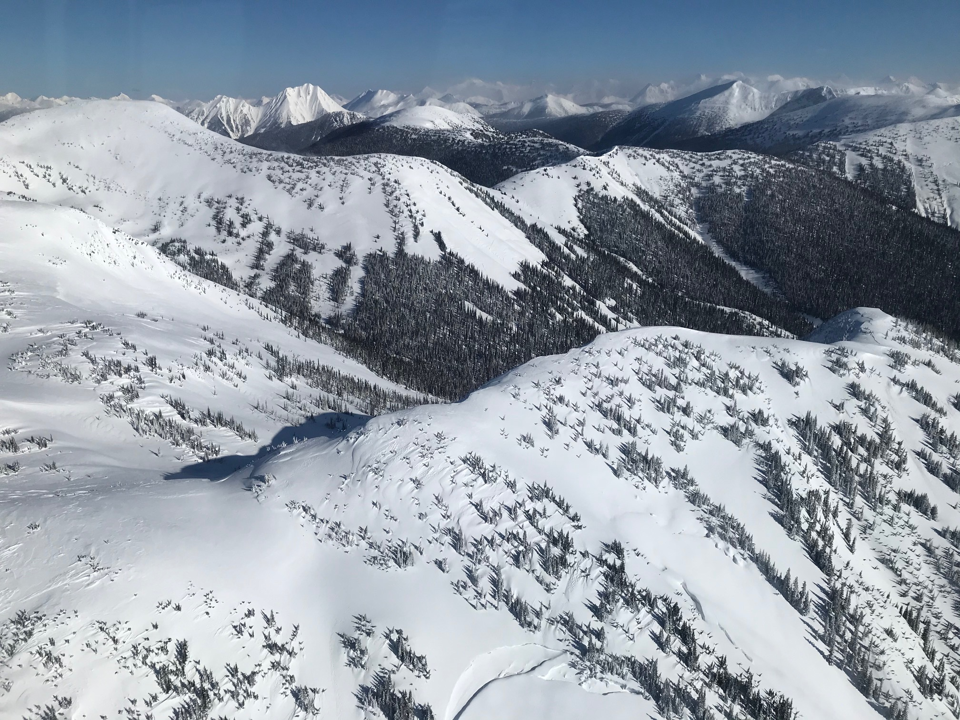
Exploring Options for Meeting
Habitat Requirements that will Allow for
Long-Term Recovery of Caribou
Presented to the Revelstoke Complex and Central Selkirks
Technical Working Group Subgroup
by
BC Caribou Recovery Science Team representatives:
Kathi Zimmerman, Bevan Ernst, Aaron Reid and Leo DeGroot
May 25, 2021

Slide 2
We are here today to talk about…
Sharing and building knowledge and understanding from all perspectives to work towards collaborative options that could achieve recovery for caribou
Review preliminary information of Scenarios the Caribou Recovery Science Team has been exploring for how to achieve recovery while mitigating impacts to timber harvest
Discuss Scenarios “without prejudice” – this is not intended to impact Indigenous Nations rights and title
Think broadly and consider influence of neighbouring herds, TSAs/TFLs & communities
Ask questions and have open and respectful dialogue

Slide 3
Habitat is foundational to recovering caribou
“Without incremental habitat protection, there is no long-term solution that keeps caribou on the landscape without constant management interventions.”
– Darcy Peel
What does recovery mean? Self-sustaining
What do caribou need to meet their habitat requirements? Food, shelter, escape
Is there room for flexibility?
What would the timber volume impacts be?
What other impacts need to be considered?

Slide 4
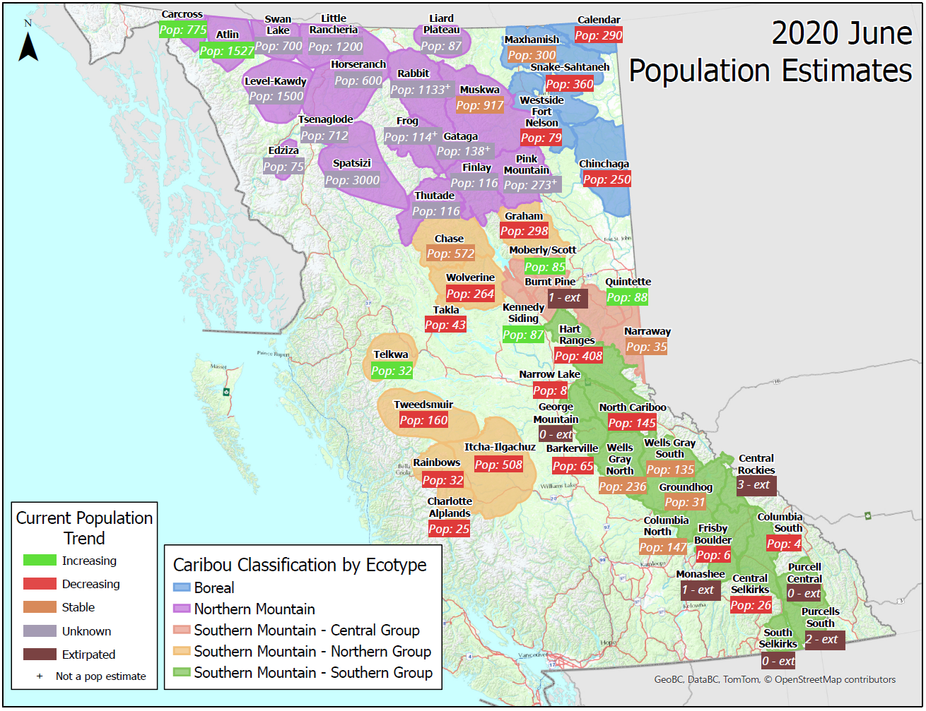
Caribou in BC:
55 herds
5 ecotypes
SARA-listed
Scenarios explored in Southern Group, expanding to Northern Group
Every herd area IS unique, no one-size-fits all solution
Southern Mtn Caribou are Threatened under SARA – Recovery Strategy, 2014

Slide 5
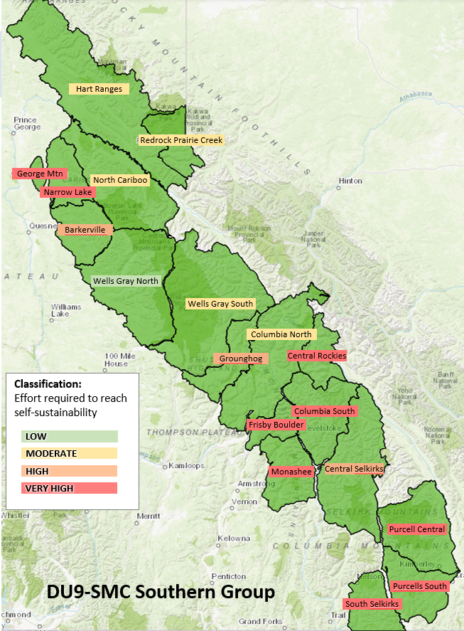
SMC DU9 – population estimates, status and recommended targets
# | Herd | *Effort to reach self-sust. | Pop'n Est | Current trend | Historic Long-term trend | Pop Target Recom. Range
1 | Hart Ranges | 2 | 408 | Decreasing | ↓ | 610-715
2 | Wells Gray North | 1 | 236 | Stable | ↔ | 235-295
3 | Columbia North | 2 | 147 | Stable | ↓ | 205-270
4 | North Cariboo | 2 | 145 | Decreasing | ↓ | 250-285
5 | Wells Gray South | 2 | 135 | Stable | ↓ | 205-335
6 | Barkerville | 3 | 65 | Decreasing | ↔ | 85-95
7 | Groundhog | 3 | 31 | Stable | ↓ | 65-80
8 | Central Selkirks | 3 | 26 | Decreasing | ↓ | 100-210
9 | Narrow Lake | 4 | 8 | Decreasing | ↓ | -
10 | Frisby-Boulder | 4 | 6 | Decreasing | ↓ | -
11 | Columbia South | 4 | 4 | Decreasing | ↓ | -
12 | Purcells South | 4 | 2 | Extirpated | ↓ | -
13 | Central Rockies | 4 | 0 | Extirpated | ↓ | -
14 | George Mountain | 4 | 0 | Extirpated | ↓ | -
15 | Monashee | 4 | 0 | Extirpated | ↓ | -
16 | Purcell Central | 4 | 0 | Extirpated | ↓ | -
17 | South Selkirks | 4 | 0 | Extirpated | ↓ | -
HOLD

Slide 6
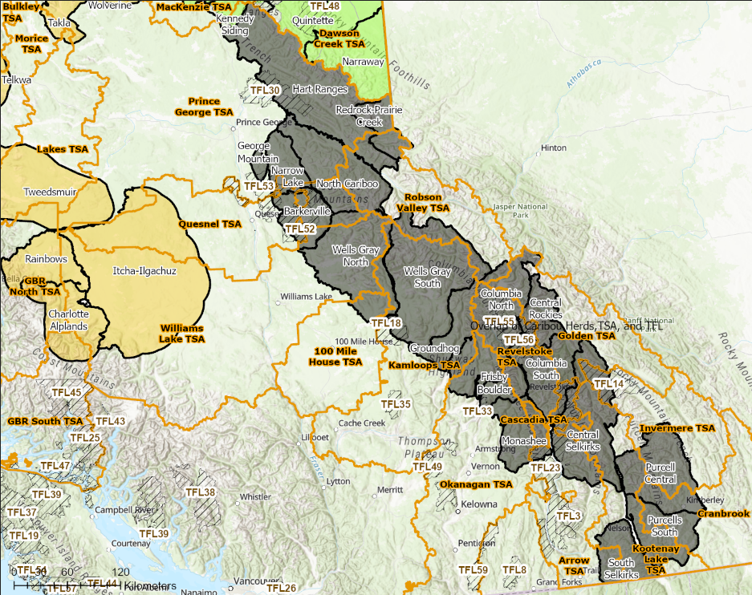
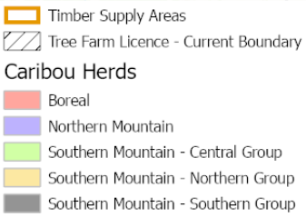
Landscape-level Approach
Consider connectivity between herds to allow for immigration/emigration and genetic flow
Consider overlap with TSAs and TFLs
Consider cumulative impacts when multiple herds overlap an operating area or when multiple TSAs overlap one herd.

Slide 7
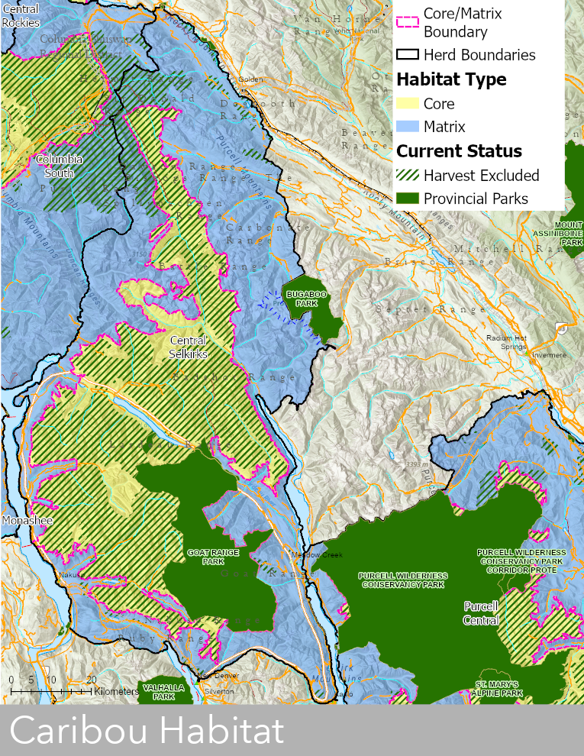
Habitat Types
Example: Central Selkirks
Core Habitat
The area that provides sufficient suitable range to support the life history requirements of caribou across all seasons and allows for movements on the landscape over time in response to human-caused and natural habitat disturbance.
Seasonal Ranges:
HESR: High-Elevation Summer Range
HEWR: High-Elevation Winter Range
HEWSR: High-Elevation Winter and Summer Range
Matrix Habitat
The area adjacent to core habitat that has periodic or low use by caribou but supports primary prey and associated predators that have the potential to affect the caribou subpopulation.

Slide 8
Habitat Scenarios for Southern Group Herds
Scenario 1: Maximum effort – Protect 100% of CORE and MATRIX habitat
Scenario 2: High effort (~Federal Recovery Strategy)
Protect 100% of CORE habitat, constrain disturbance in MATRIX as per the Species at Risk Act, for all 17 DU9 herds
Scenario 3: Moderate-High effort
Protect prioritized CORE habitat, constrain disturbance in prioritized MATRIX for the 8 herds that have >20 animals
Identify High, Medium and Low priority habitat based on Science Team input:
  Include High, Medium and Low priority areas per Science Team input
  Include High and Medium priority areas per Science Team input
  Include High priority areas per Science Team input
Scenario 4: Lowest effort - No additional protections or disturbance constraints in CORE or MATRIX
Recommended Option
Low risk to caribou for prioritized herds
Reduces timber volume impacts

Slide 9
DU9 – Habitat Disturbance and Protection Levels for Prioritized Herds
Herds and Status |  |  |  |  | % Hab. Disturbance |  | % Habitat Protection
Herd | *Effort to reach self-sust. | Pop'n Est | Current trend | Historic Long-term trend | Matrix (no buffer |buffer) | HE Core (500m buffer) | Matrix current protection | HE Core current protection
Hart Ranges | 2 | 408 | Decreasing | ↓ | 16|65 | 5.1 | 5% | 90%
Wells Gray North | 1 | 236 | Stable | ↔ | 22|76 | 24.2 | 26% | 82%
Columbia North | 2 | 147 | Stable | ↓ | 17|50 | 33.6 | 12% | 34%
North Cariboo | 2 | 145 | Decreasing | ↓ | 20|58 | 12.9 | 29% | 89%
Wells Gray South | 2 | 135 | Stable | ↓ | 14|49 | 19.7 | 29% | 82%
Barkerville | 3 | 65 | Decreasing | ↔ | 35|93 | 68.9 | 16% | 36%
Groundhog | 3 | 31 | Stable | ↓ | 26|80 | 44.6 | 13% | 65%
Central Selkirks | 3 | 26 | Decreasing | ↓ | 11|42 | 26.8 | 11% | 85%
Notes:
Prioritization work strives to reach near 90% protection within the High and Medium options and ~85% with just High.

Slide 10
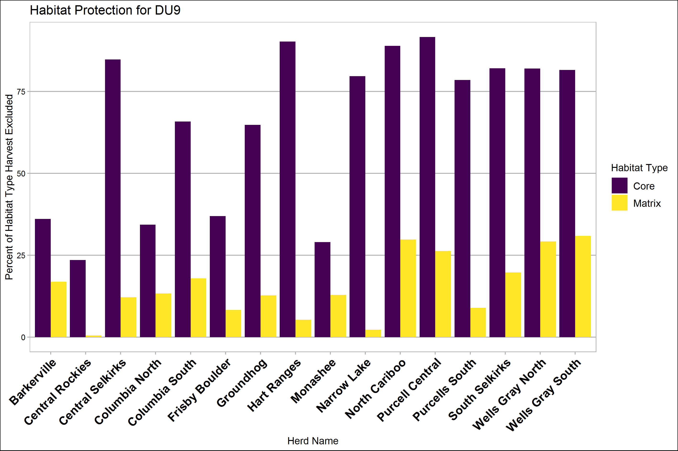
Habitat Protection Levels (%) for all DU9 Herds
Resource Review Area
National Park
Ecological Reserves
Provincial Parks (Class A)
Provincial Parks (Class C)
Conservancies
Protected Areas
Conservation Lands, Administered Lands
Wildlife Management Areas
Creston Valley Wildlife Management Area
NGO Fee Simple Conservation Lands
Mineral Reserve Sites
Ungulate Winter Range, No Harvest
Wildlife Habitat Areas, No Harvest
Biodiversity Mining and Tourism Areas
Special Wildland RMZ in Muskwa Kechika Mgmt Area
Old Growth Management Areas - Legal Current
VQO Preserves
Class1 Coast Grizzly Bear Habitat (Coast LUP)
Forest Rec Sites
VQO Retention
Special Management RMZ in Muskwa Kechika MA
Land Act Reserves (Section 15, 16, 17, 66)
Ungulate Winter Range, Conditional Harvest
Wildlife Habitat Areas, Conditional harvest
VQO Partial Retention
VQO Modify
Community Watersheds
VQO Maximum Modify
Class2 Coast Grizzly Bear Habitat
Fisheries Sensitive Watersheds
Important Fisheries Watersheds (Great Bear Rainforest LUO)
GBRO Area (Great Bear Rainforest LUO EBM Areas)
Atlin-Taku Resource Management Areas
Atlin-Taku Forest Retention Areas

Slide 11
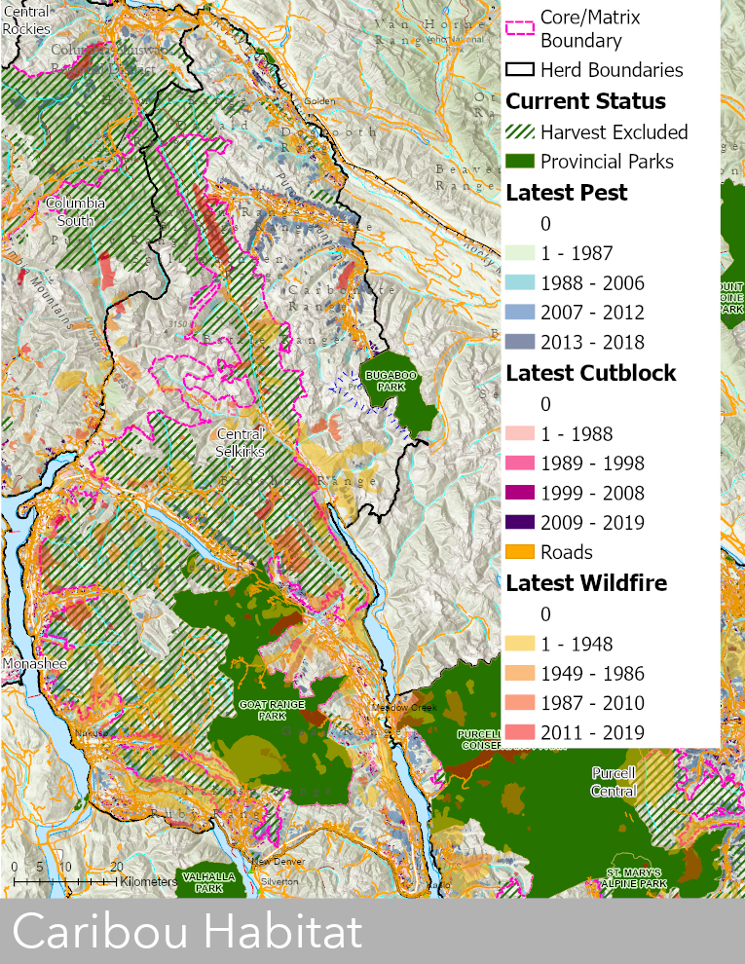
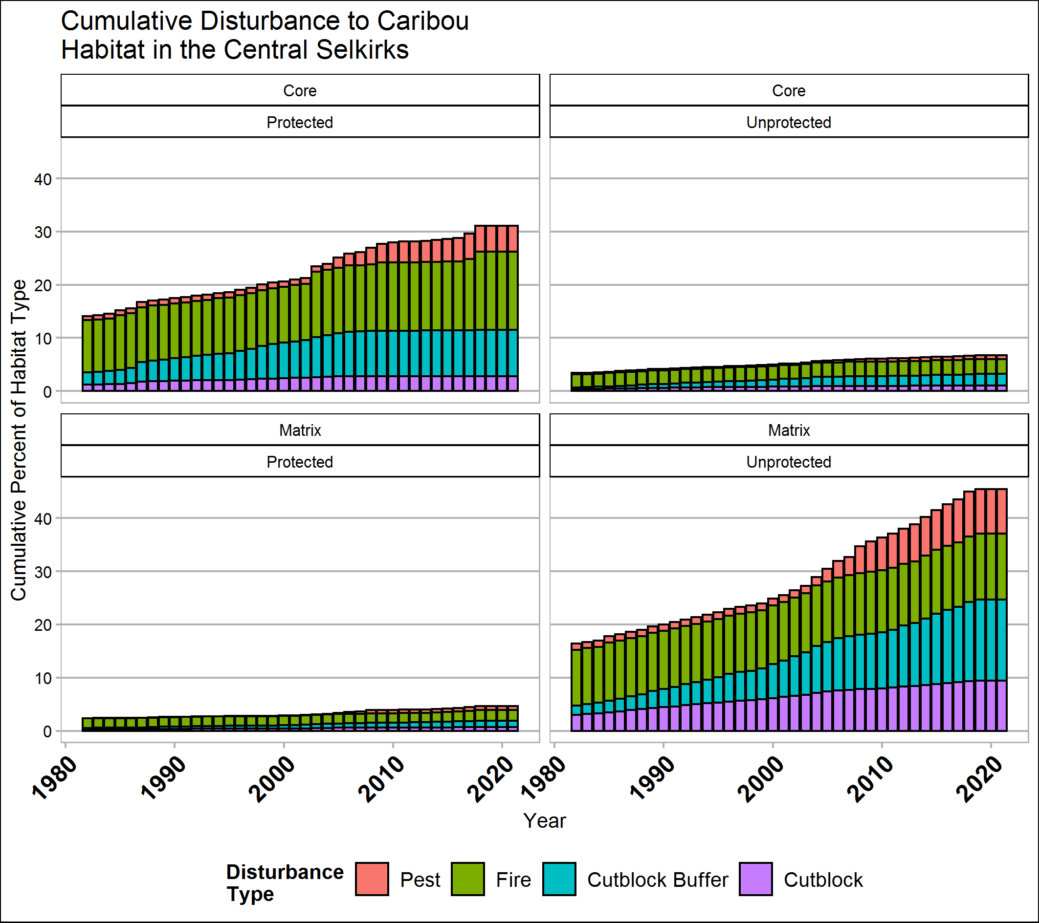
Habitat Disturbance – Central Selkirks
Cutblocks, Wildfires & Pests

Slide 12
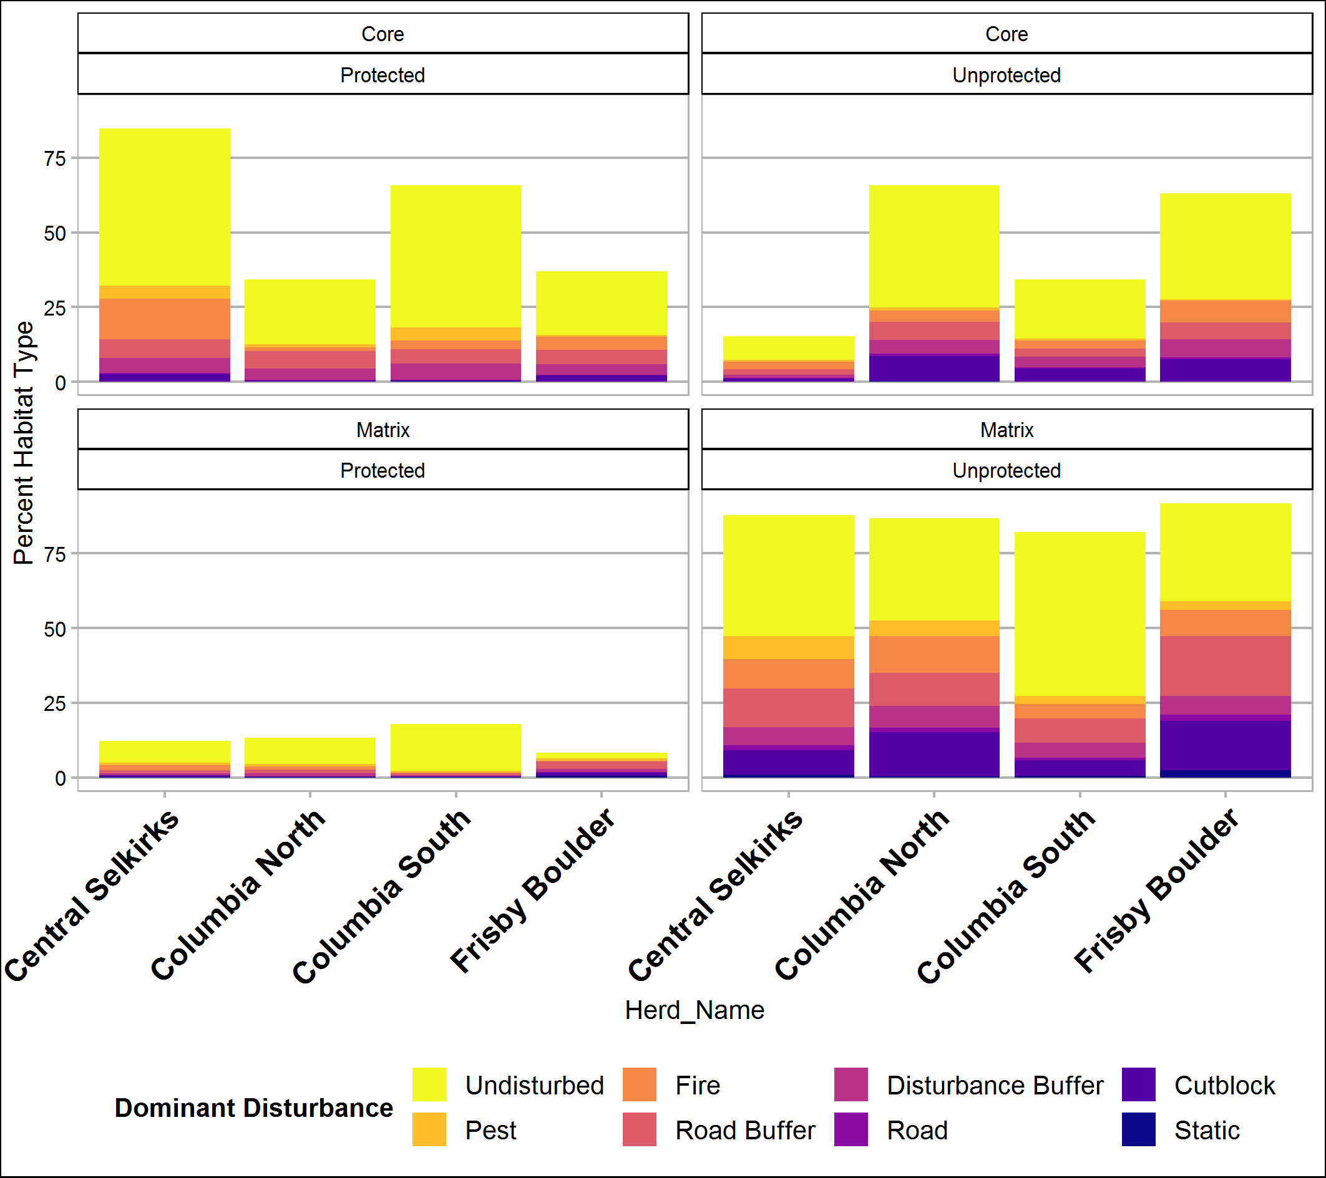
Habitat Disturbance (%)
*
Cumulative levels of disturbance for all four herds.
*The area of focus for additional protections in CORE is the unprotected, undisturbed areas (in yellow)
*

Slide 13
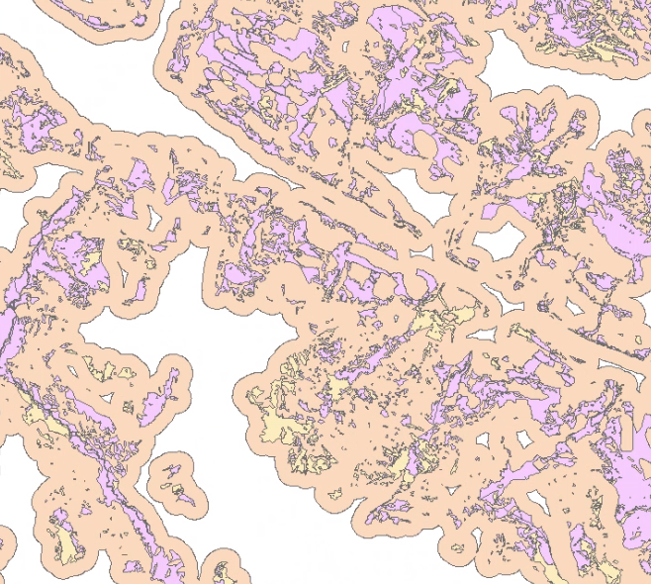
Criteria for Prioritizing Habitat for Additional Protection
CORE habitat:
Undisturbed
Forested
>100yrs to protect existing habitat
>80 years old to protect recruitment habitat
Unprotected or insufficient protection
<60% slope
Buffered to minimize patchiness
Legend
3a. Old Forest
3a. Recruitment Forest
3b. Buffer
example area
Notes:
SME advice could include: assess age classes based on NDTs and local conditions, capture high-use areas, movement corridors, contiguous habitat…
- Disturbance: 12% based on the average Matrix disturbance multiplier for DU9 & DU7 of 2.22, per disturbance analysis. 15% based on Tyler’s analysis, specific to forestry.

Slide 14
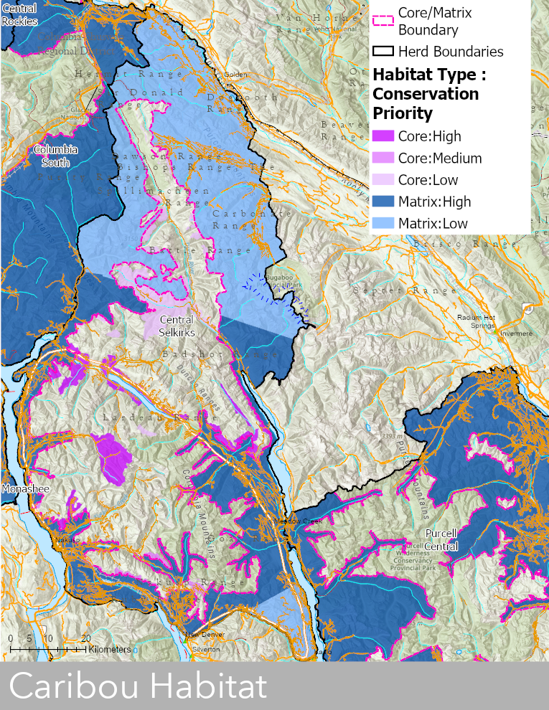
BC Caribou Science Team Prioritizations
Criteria for prioritizing (High/Medium/Low) where additional protections would be most effective:
Level of habitat use determined by current and historic telemetry locations
Level of existing disturbance (esp. fire, pests and cutblocks), and potential for restoration or recovery
Habitat suitability as determined through models
Connectivity to allow for immigration & emigration

Slide 15
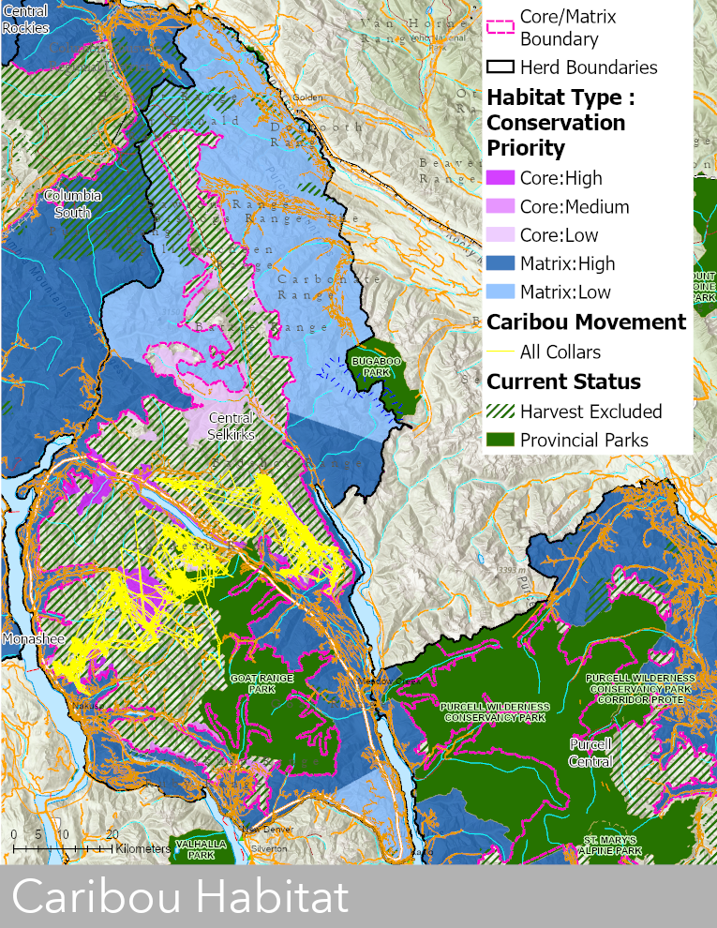
Telemetry Movement Lines
Central Selkirks
12-15 collared caribou,
March 2017 to August 2020

Slide 16
Recommended Management Actions to Recover SG1-3 Herds
Habitat Management
Population Management
Herd | *Effort to reach self-sust. | Last Est. Year | Pop'n Est | Current trend | Historic Long-term trend | 1a.Hab Prot-CORE | 1b.Hab Mgmt-MATRIX | 2.Hab Restor-ation | 3.Pred Mgmt | 4.Prey Mgmt | 5.Rec'n Mgmt | 6.Mat Pen | 7.Supp'l Feed | 8.Aug'n
Hart Ranges | 2 | 2020 | 408 | Decreasing | ↓ | Maybe | YES | YES | YES | YES | YES | NO | NO | NO
Wells Gray North | 1 | 2020 | 236 | Stable | ↔ | YES | YES | YES | Maybe | Maybe | YES | NO | NO | NO
Columbia North | 2 | 2017 | 147 | Stable | ↓ | YES | YES | YES | YES | YES | YES | NO | NO | NO
North Cariboo | 2 | 2020 | 145 | Decreasing | ↓ | Maybe | YES | NO | YES | YES | YES | NO | NO | NO
Wells Gray South | 2 | 2020 | 135 | Stable | ↓ | Maybe | YES | YES | Maybe | Maybe | YES | NO | NO | NO
Barkerville | 3 | 2020 | 65 | Decreasing | ↔ | YES | YES | YES | Maybe | Maybe | YES | NO | NO | NO
Groundhog | 3 | 2020 | 31 | Stable | ↓ | Maybe | YES | YES | Maybe | Maybe | YES | NO | NO | NO
Central Selkirks | 3 | 2020 | 26 | Decreasing | ↓ | YES | YES | YES | YES | YES | YES | YES | NO | Maybe
Scenarios
YES = Recommend implementing or continuing this action
Maybe = conditional (e.g. if stable status changes)
NO = Do not recommend this action
Pink = past/current management actions
Notes:
High-level prescription for recovering DU9 herds through habitat and population mgmt. actions - habitat is the focus of the scenarios; further restoration and population mgmt actions are required for most herds while habitat recovers

Slide 17
Next Steps
Include Indigenous Knowledge
Expand science-based input
Model projected timber volume impacts
Other potential next steps?

